Slide 1
Reviewing Cathedrals! Chapter 18

Slide 2
St. Denis, France

Slide 3
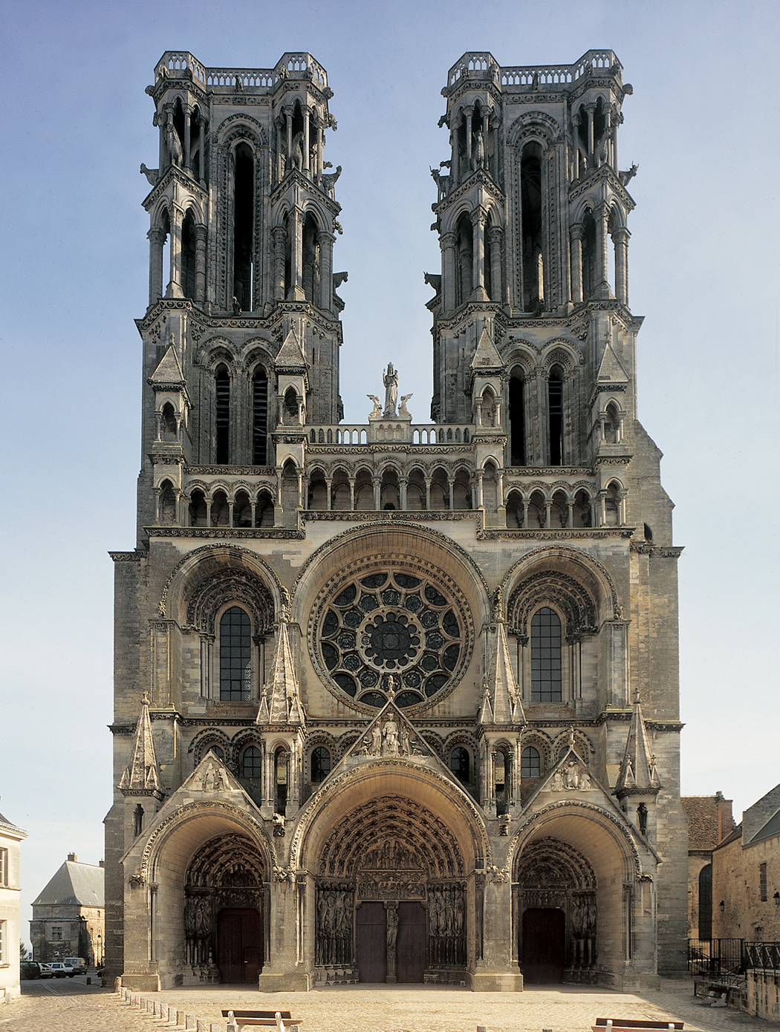
Laon Cathdral, France

Slide 4
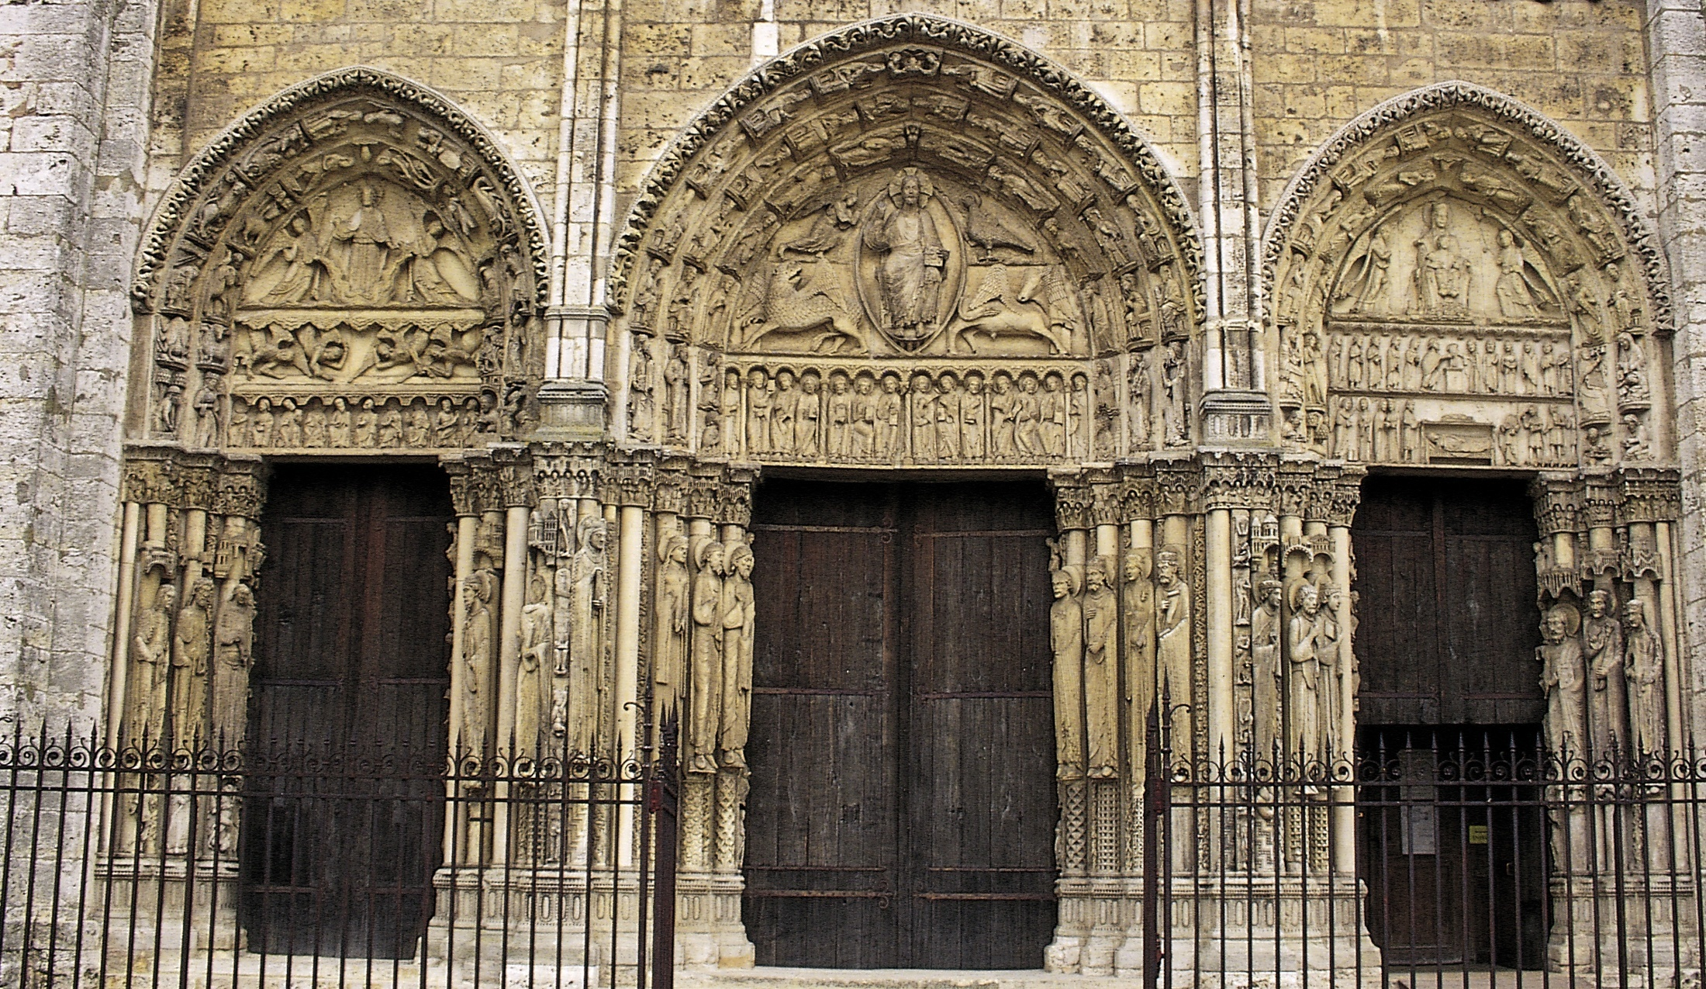
Royal Portal Chartres, France

Slide 5
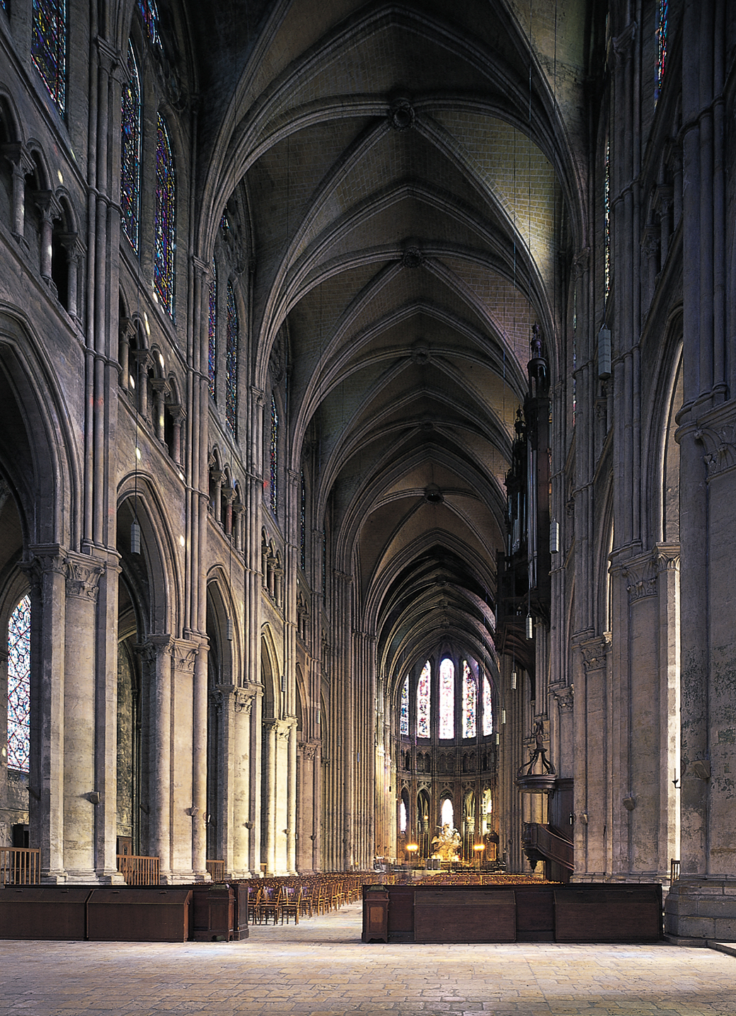
Chartres Cathedral, France

Slide 6
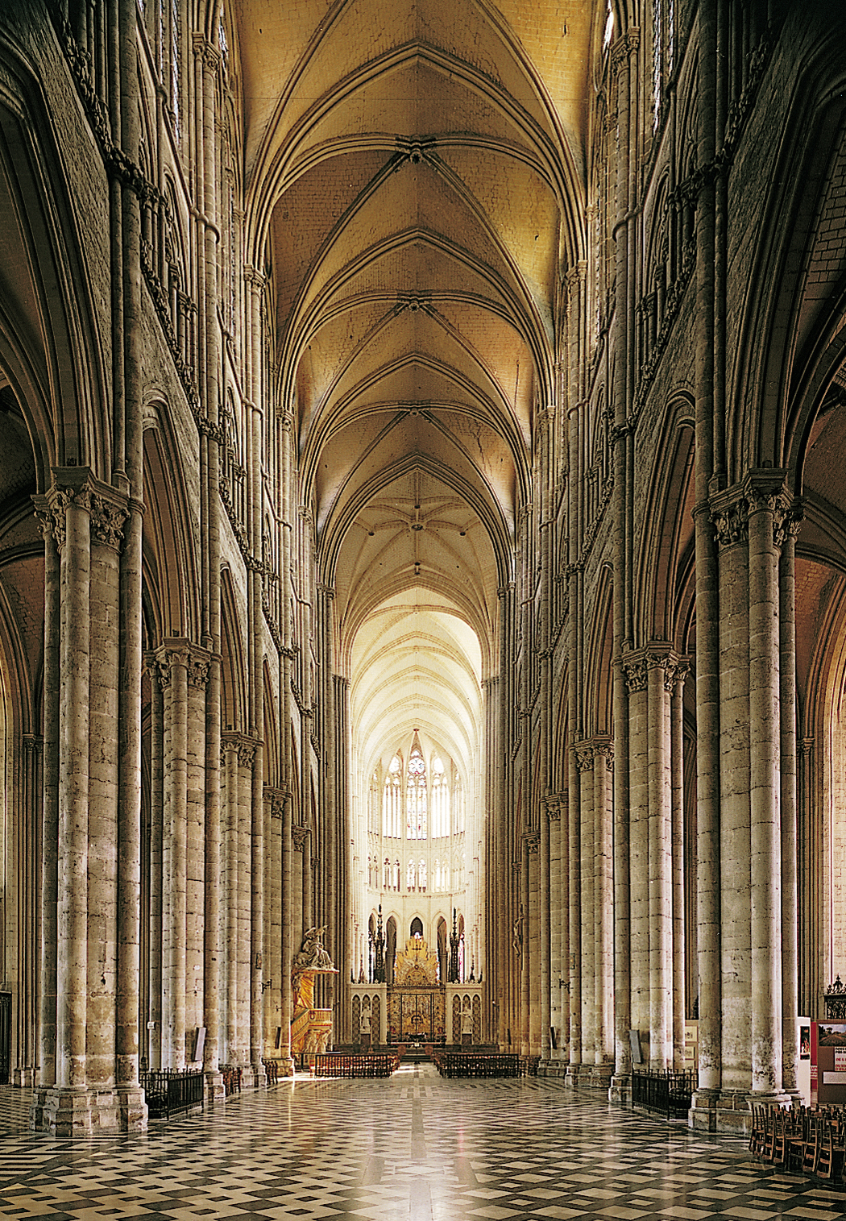
Amiens Cathedral, France

Slide 7
Milan Cathedral, Italy

Slide 8
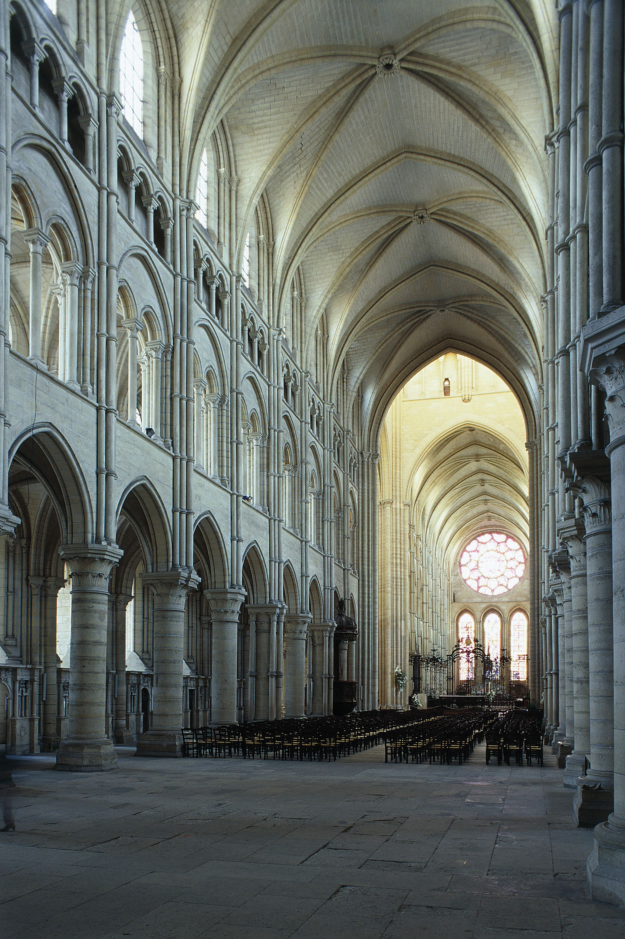
Laon Cathedral, France

Slide 9
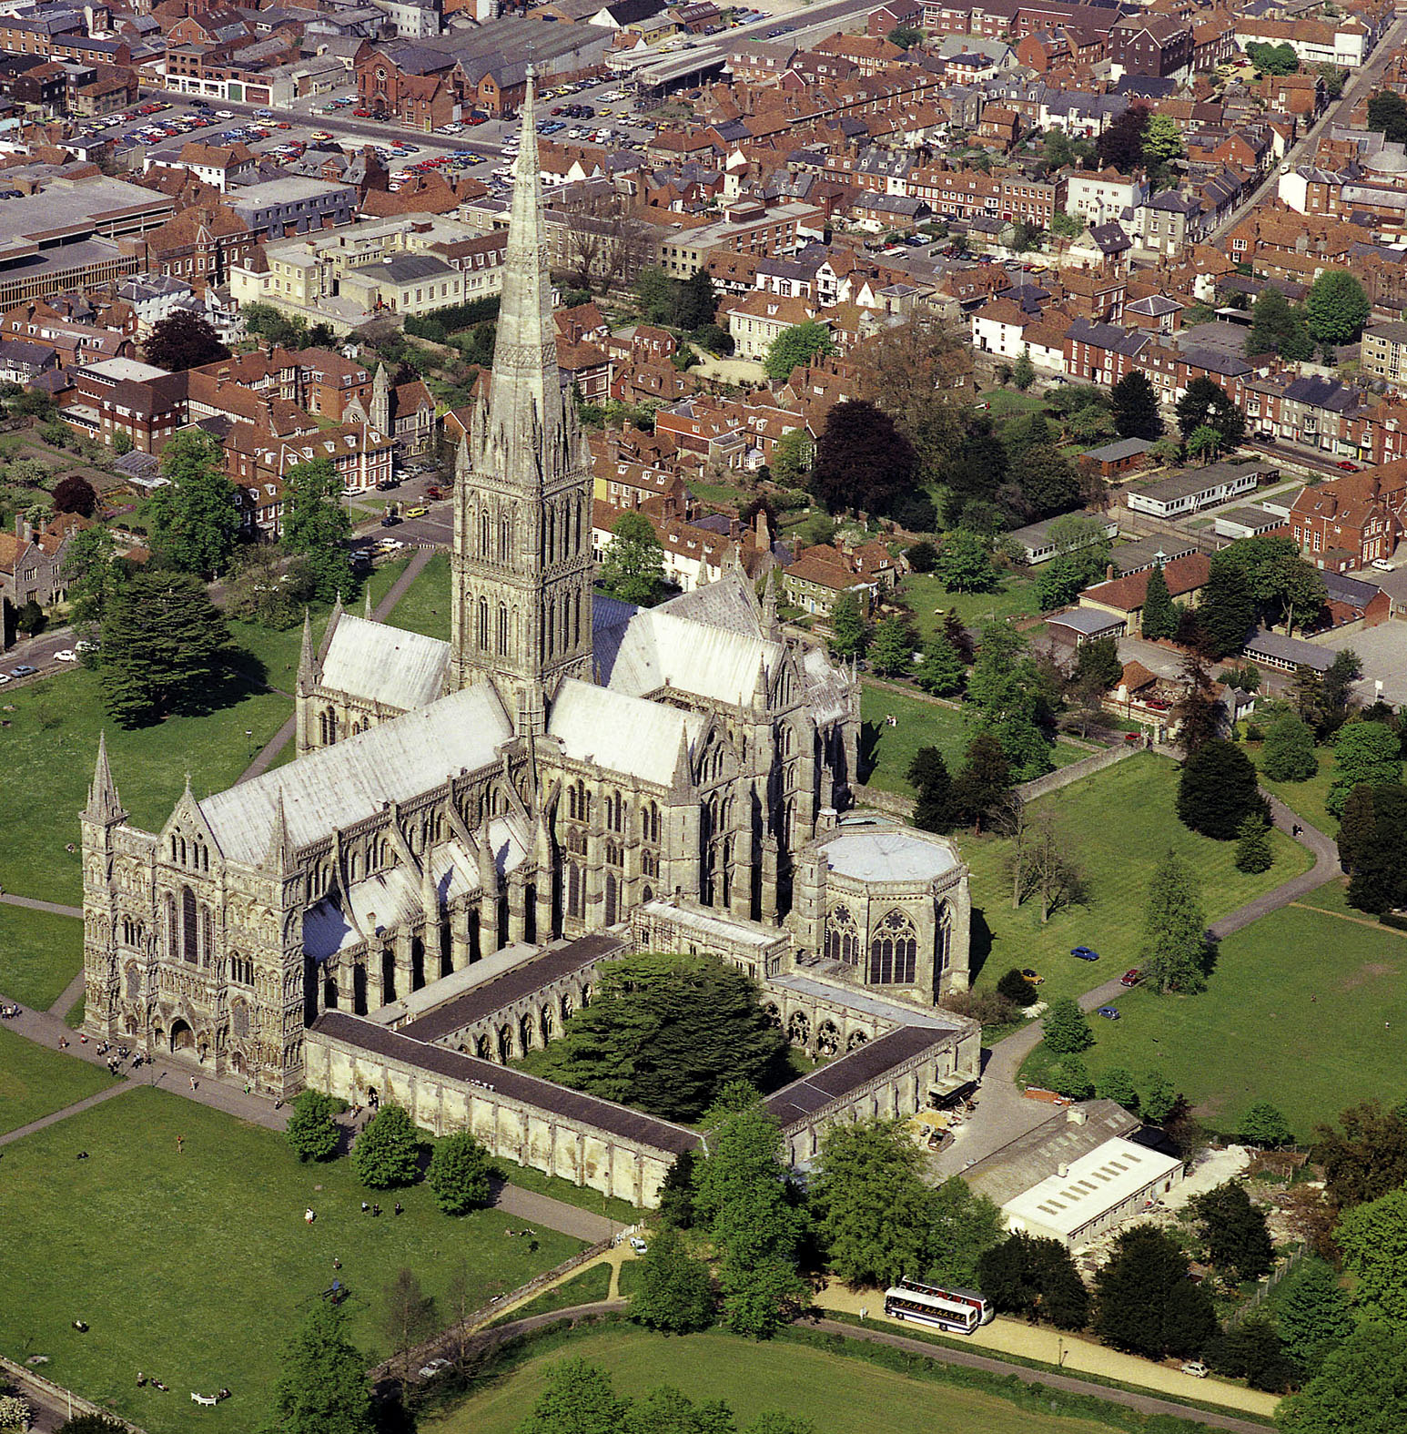
Salisbury Cathedral, England

Slide 10
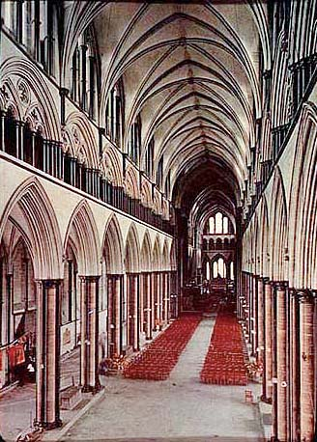
Salisbury Cathedral, England

Slide 11
Royal Portal Chartres, France

Slide 12
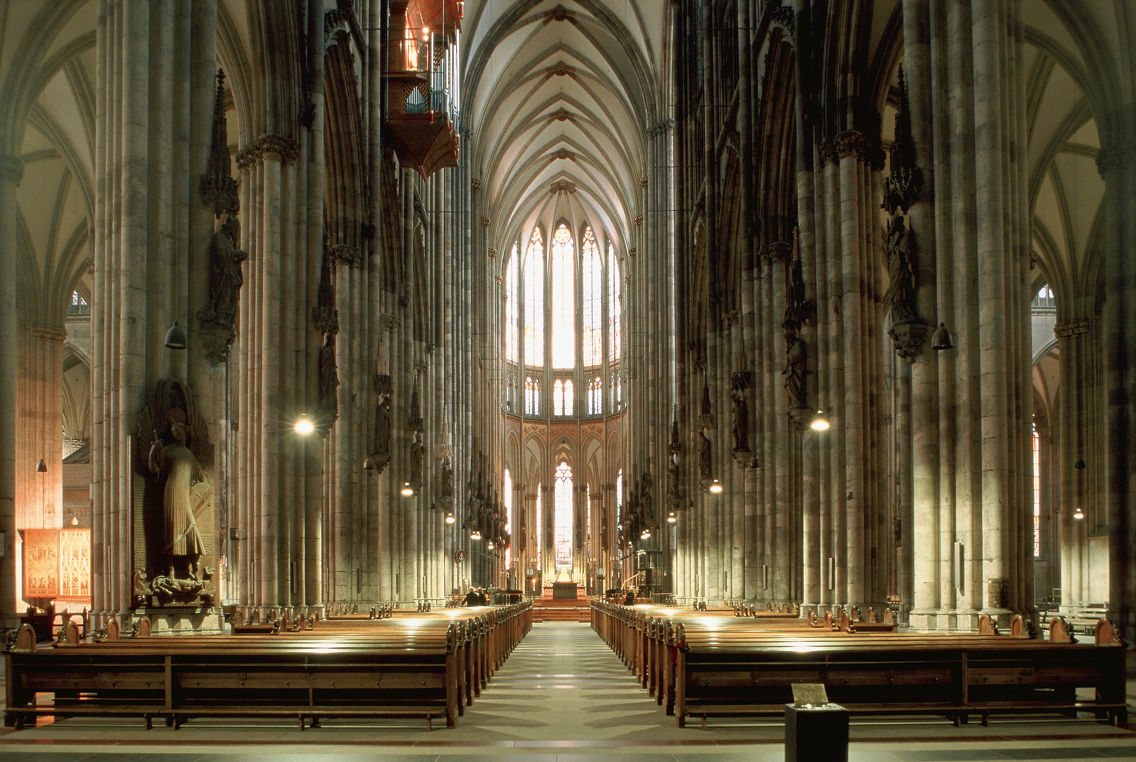
Cologne Cathedral, Germany

Slide 13
Oriveto Cathedral, Italy

Slide 14
Salisbury Cathedral, England

Slide 15
Cologne Cathedral, Germany

Slide 16
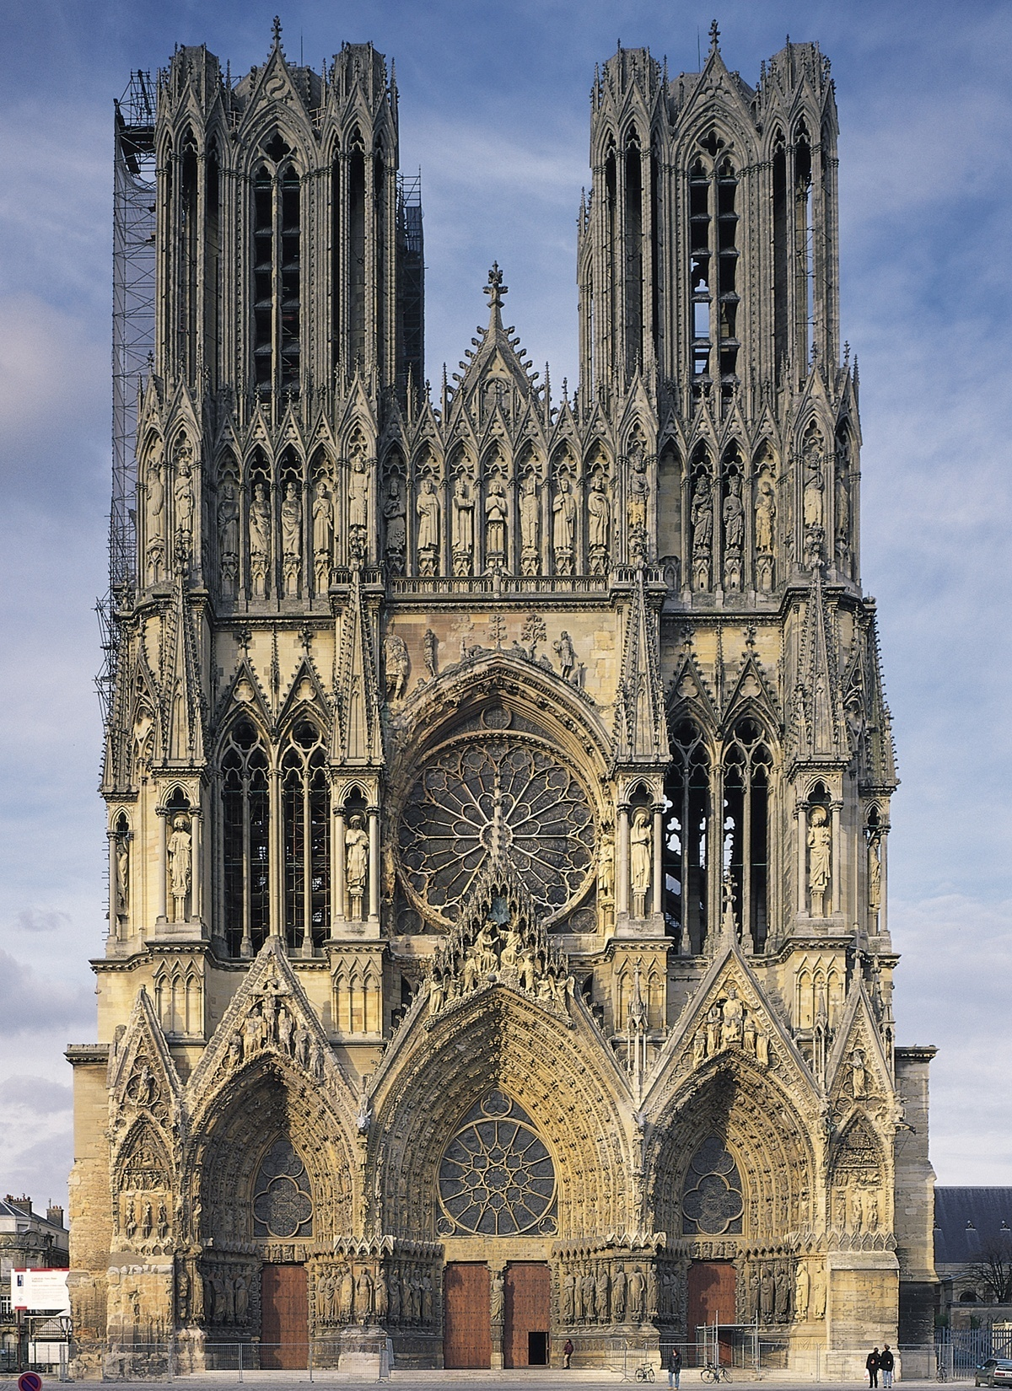
Reims, France

Slide 17
Notre Dame, Paris, France

Slide 18
Orvieto Cathedral, Italy

Slide 19
Milan Cathedral, Italy

Slide 20
St. Denis, France

Slide 21
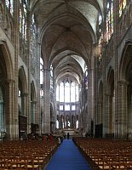
St. Denis, France

Slide 22
Laon Cathedral, France

Slide 23
Laon Cathdral, France

Slide 24
Chartres Cathedral, France

Slide 25
Reims, France

Slide 26
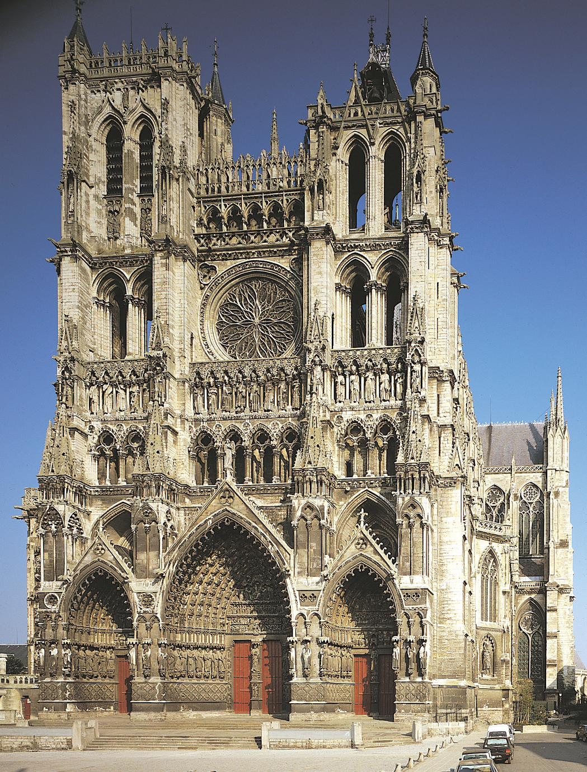
Amiens, France

Slide 27
Amiens Cathedral, France

Slide 28
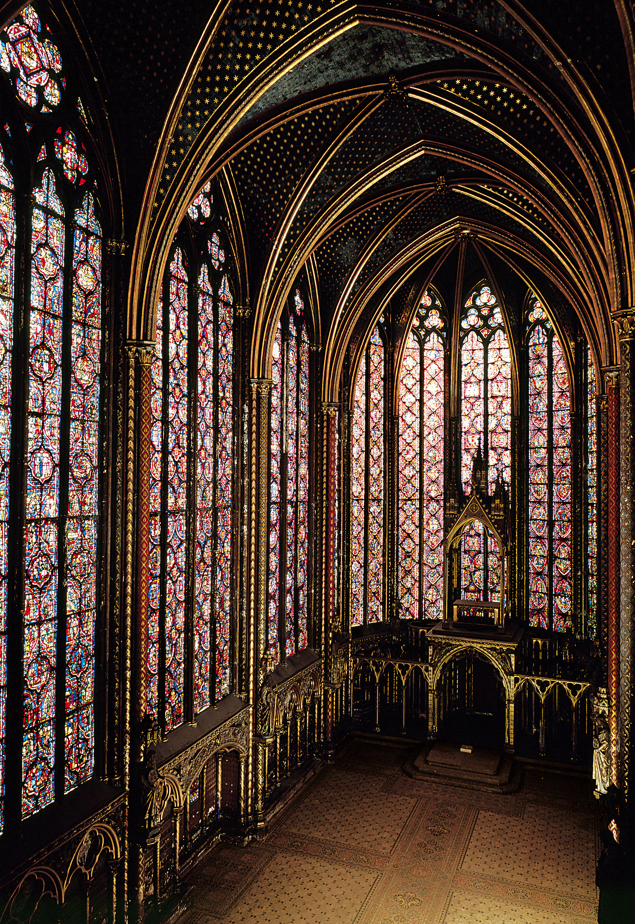
Sainte Chapelle, France

Slide 29
Notre Dame, Paris, France

Slide 30
Salisbury Cathedral, England

Slide 31
Amiens, France

Slide 32
Cologne Cathedral, Germany

Slide 33
Cologne Cathedral, Germany

Slide 34
St. Denis, France

Slide 35
St. Denis, France

Slide 36
Laon Cathdral, France

Slide 37
Royal Portal Chartres, France

Slide 38
Chartres Cathedral, France

Slide 39
Amiens Cathedral, France

Slide 40
Milan Cathedral, Italy

Slide 41
Laon Cathedral, France

Slide 42
Salisbury Cathedral, England

Slide 43
Orvieto Cathedral, Italy

Slide 44
Salisbury Cathedral, England

Slide 45
Amiens, France

Slide 46
Cologne Cathedral, Germany

Slide 47
Sainte Chapelle, France

Slide 48
Reims, France

Slide 49
Notre Dame, Paris, France

Slide 50
Salisbury Cathedral, England

Slide 51
Royal Portal Chartres, France

Slide 52
Milan Cathedral, Italy

Slide 53
St. Denis, France

Slide 54
Orvieto Cathedral, Italy

Slide 55
Sainte Chapelle, France

Slide 56
St. Denis, France

Slide 57
Laon Cathedral, France

Slide 58
Laon Cathdral, France

Slide 59
Chartres Cathedral, France

Slide 60
Reims, France

Slide 61
Cologne Cathedral, Germany

Slide 62
Amiens Cathedral, France

Slide 63
Notre Dame, Paris, France

Slide 64
Salisbury Cathedral, England

Slide 65
Amiens, France

Slide 66
Cologne Cathedral, Germany

Slide 67
Cologne Cathedral, Germany

Slide 68
St. Denis, France

Slide 69
Sainte Chapelle, France

